Slide 1
Unit 6: Fuzzy Logic
Lecture 2

Slide 2
Membership Functions
Membership functions allow you to quantify linguistic term and represent a fuzzy set graphically. A membership function for a fuzzy set A on the universe of discourse X is defined as µA:X → [0,1]. Here, each element of X is mapped to a value between 0 and 1. It is called membership value or degree of membership. It quantifies the degree of membership of the element in X to the fuzzy set A.
• x axis represents the universe of discourse.
• y axis represents the degrees of membership in the [0, 1] interval.

Slide 3
Operations of fuzzy sets
The classical set theory developed in the late 19th century by Georg Cantor describes how crisp sets can interact. These interactions are called operations.
We look at three of them: complement, intersection and union.
Complement
Crisp sets: Who does not belong to the set?
Fuzzy sets: How much do elements not belong to the set?
The complement of a set is an opposite of this set. For example, if we have the set of tall men, its complement is the set of NOT tall men. When we remove the tall men set from the universe of discourse, we obtain the complement. If A is the fuzzy set, its complement ~A can be found as follows:

Slide 4

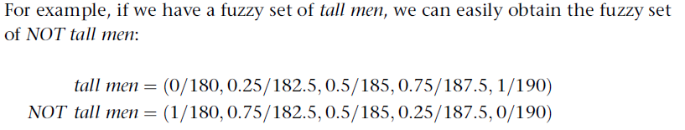

Slide 5
Intersection
Crisp sets: Which element belongs to both sets?
Fuzzy sets: How much of the element is in both sets?
In classical set theory, an intersection between two sets contains the elements shared by these sets. If we have, for example, the set of tall men and the set of fat men, the intersection is the area where these sets overlap, i.e. Tom is in the intersection only if he is tall AND fat.
In fuzzy sets, however, an element may partly belong to both sets with different memberships. Thus, a fuzzy intersection is the lower membership in both sets of each element.
The fuzzy operation for creating the intersection of two fuzzy sets A and B on universe of discourse X can be obtained as:

Slide 6
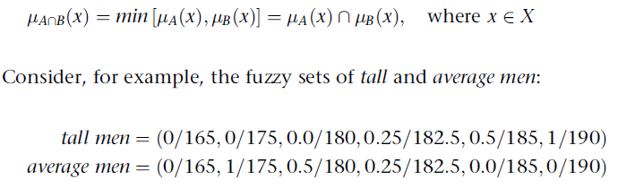

Slide 7
Union
Crisp sets: Which element belongs to either set?
Fuzzy sets: How much of the element is in either set?
The union of two crisp sets consists of every element that falls into either set. For example, the union of tall men and fat men contains all men who are tall OR fat, i.e. Tom is in the union since he is tall, and it does not matter whether he is fat or not.
In fuzzy sets, the union is the reverse of the intersection. That is, the union is the largest membership value of the element in either set. The fuzzy operation for forming the union of two fuzzy sets A and B on universe X can be given as:

Slide 8
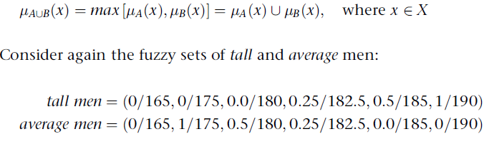

Slide 9
If-Then Rules
Fuzzy sets and fuzzy operators are the subjects and verbs of fuzzy logic. These if-then rule statements are used to formulate the conditional statements that comprise fuzzy logic.
A single fuzzy if-then rule assumes the form
if x is A then y is B
where, A and B are linguistic values defined by fuzzy sets on the ranges (universes of discourse) X and Y, respectively. The if-part of the rule "x is A" is called the antecedent or premise, while the then-part of the rule "y is B" is called the consequent or conclusion. An example of such a rule might be
If service is good then tip is average
Note that good is represented as a number between 0 and 1, and so the antecedent is an interpretation that returns a single number between 0 and 1. On the other hand, average is represented as a fuzzy set, and so the consequent is an assignment that assigns the entire fuzzy set B to the output variable y.

Slide 10
In the case of two-valued or binary logic, if-then rules don't present much difficulty. If the premise is true, then the conclusion is true. Let the antecedent be a fuzzy statement, how does this reflect on the conclusion? The answer is a simple one
Summary of If-Then Rules
Interpreting if-then rules is a three-part process.
Fuzzify inputs: Resolve all fuzzy statements in the antecedent to a degree of membership between 0 and 1. If there is only one part to the antecedent, this is the degree of support for the rule.
Apply fuzzy operator to multiple part antecedents: If there are multiple parts to the antecedent, apply fuzzy logic operators and resolve the antecedent to a single number between 0 and 1. This is the degree of support for the rule.
Apply implication method: Use the degree of support for the entire rule to shape the output fuzzy set. The consequent of a fuzzy rule assigns an entire fuzzy set to the output. This fuzzy set is represented by a membership function that is chosen to indicate the qualities of the consequent.

Slide 11
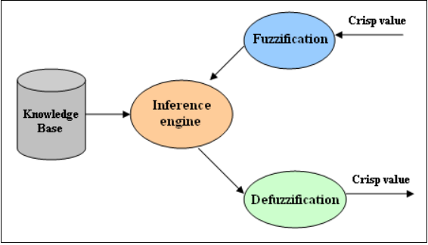
Fuzzy Logic Systems Architecture/ The Architecture of Fuzzy Inference Systems A fuzzy inference system consists of four modules:

Slide 12
Fuzzification module: transforms the system inputs, which are crisp numbers, into fuzzy sets. This is done by applying a fuzzification function.
Knowledge base: stores IF-THEN rules provided by experts.
Inference engine: simulates the human reasoning process by making fuzzy inference on the inputs and IF-THEN rules.
Defuzzification module: transforms the fuzzy set obtained by the inference engine into a crisp value.

Slide 13
Fuzzy Inference Methods
Fuzzy inference is the process of formulating the mapping from a given input to an output using fuzzy logic.
There are two types of fuzzy inference methods:
Mamdani inference method
Sugeno fuzzy inference method

Slide 14
Mamdani inference method:
Mamdani fuzzy inference is the most commonly seen inference method. This method was introduced by Mamdani and Assilian (1975).
Mamdani Fuzzy models
To compute the output of this FIS given the inputs, six steps has to be followed
1. Determining a set of fuzzy rules
2. Fuzzifying the inputs using the input membership functions

Slide 15
3. Combining the fuzzified inputs according to the fuzzy rules to establish a rule strength (Fuzzy Operations)
4. Finding the consequence of the rule by combining the rule strength and the output membership function (implication)
5. Combining the consequences to get an output distribution (aggregation)
6. Defuzzifying the output distribution (this step is only if a crisp output (class) is needed).

Slide 16
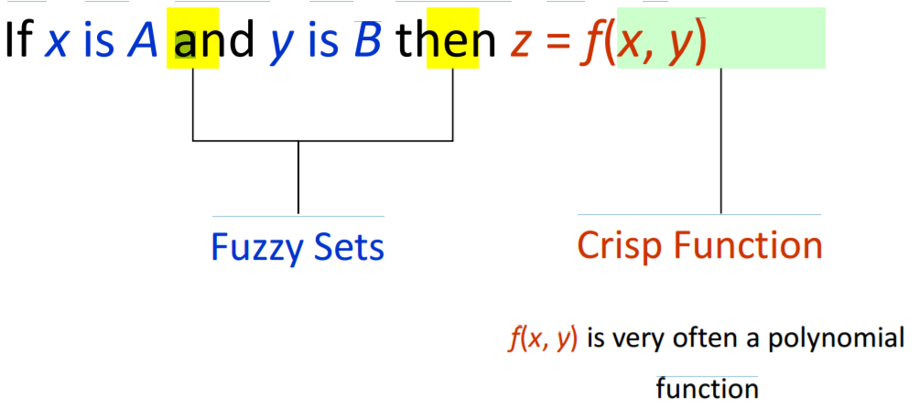
Sugeno Fuzzy Models:
Another well-known inference method is the called Sugeno or Takagi–Sugeno–Kang method of fuzzy inference process.
This method was introduced by Sugeno (1985). This method is also called as TS method. The main difference between the two methods lies in the consequent of fuzzy rules.
• Goal: Generation of fuzzy rules from a given input-output data set.
Fuzzy Rules of TSK Model

Slide 17
The most fundamental difference between Mamdani-type FIS and Sugeno-type FIS is the way the crisp output is generated from the fuzzy inputs.
While Mamdani-type FIS uses the technique of defuzzification of a fuzzy output, Sugeno-type FIS uses weighted average to compute the crisp output.
The expressive power and interpretability of Mamdani output is lost in the Sugeno FIS since the consequents of the rules are not fuzzy.
But Sugeno has better processing time since the weighted average replace the time consuming defuzzification process.
Due to the interpretable and intuitive nature of the rule base, Mamdani-type FIS is widely used in particular for decision support application.

